Slide 1

Foundation Conference and Public Meeting
Vice Chancellor’s Annual Report 2021
Professor Todd Walker
Principal and Vice Chancellor

Slide 2

Today
Changes
Achievements
New Leadership
New Strategic Plan
New Structures
Student Outcome
Staff Outcomes

Slide 3
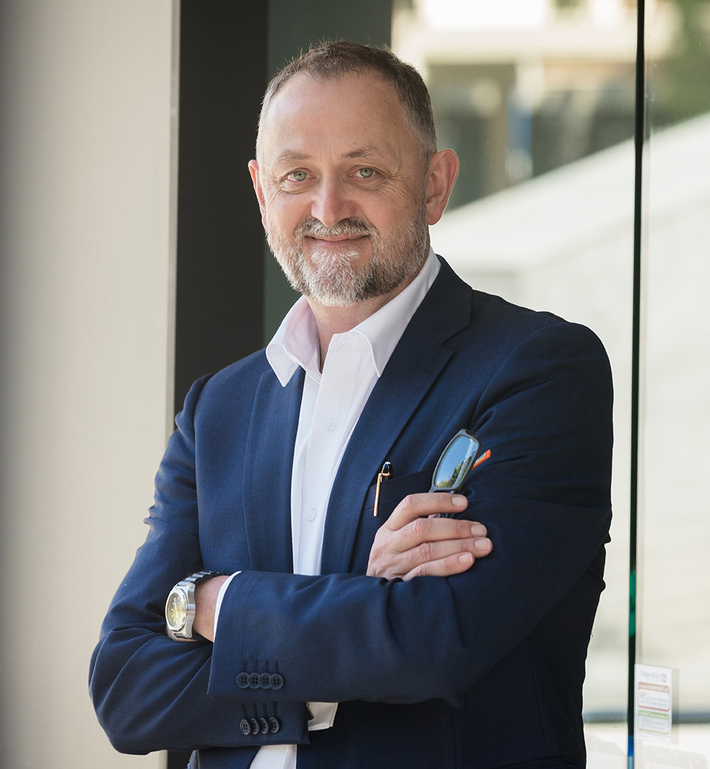
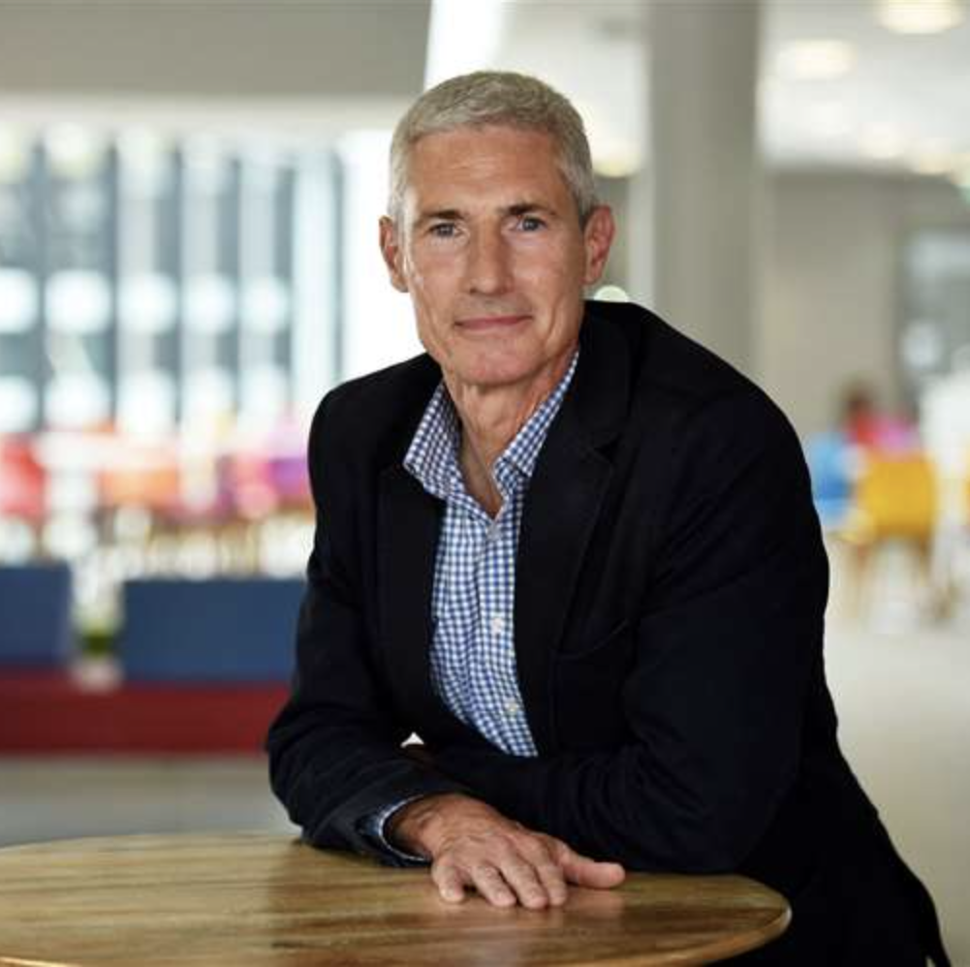
New Leadership
Vice Chancellor
Chair of Court

Slide 4

New Strategic Plan
The Daring to be Different strategic plan signals a shift in thinking, one for which our partnership is well prepared, and sets an ambition of becoming more engaged with our communities and more enterprising in our activity.

Slide 5


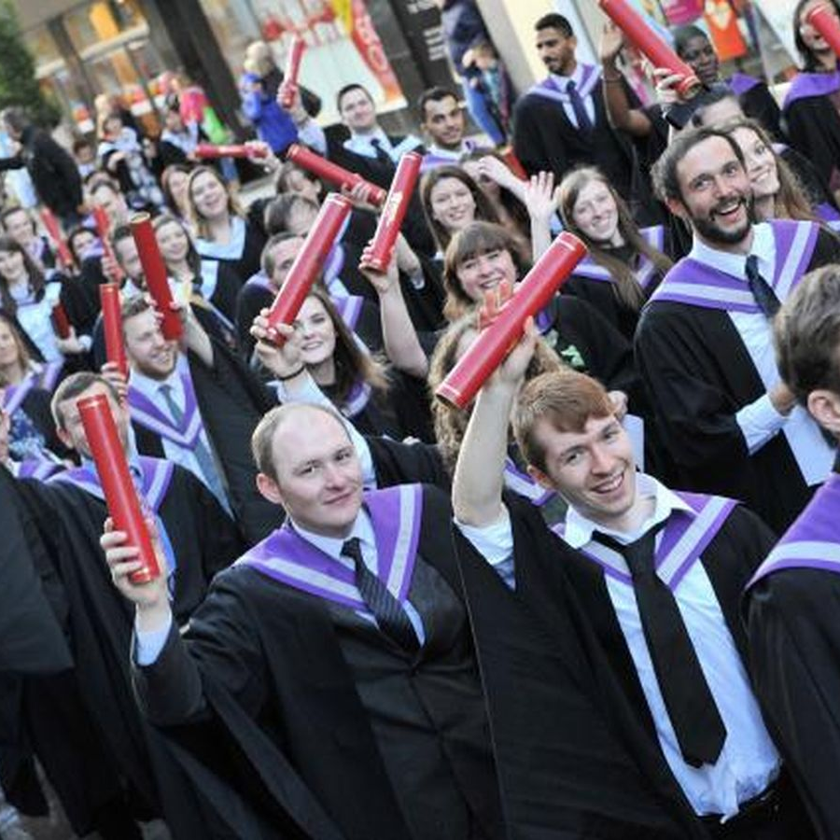
“There is an opportunity to create a renewed relationship between university, government and community in the post-covid recovery”
A NEW SOCIAL CONTRACT
Community
Government
University
The New Social Contract

Slide 6
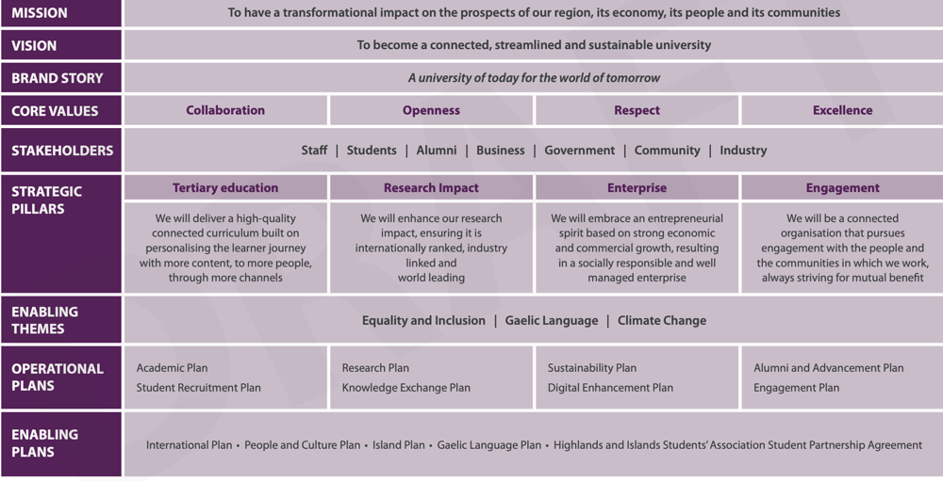

Slide 7
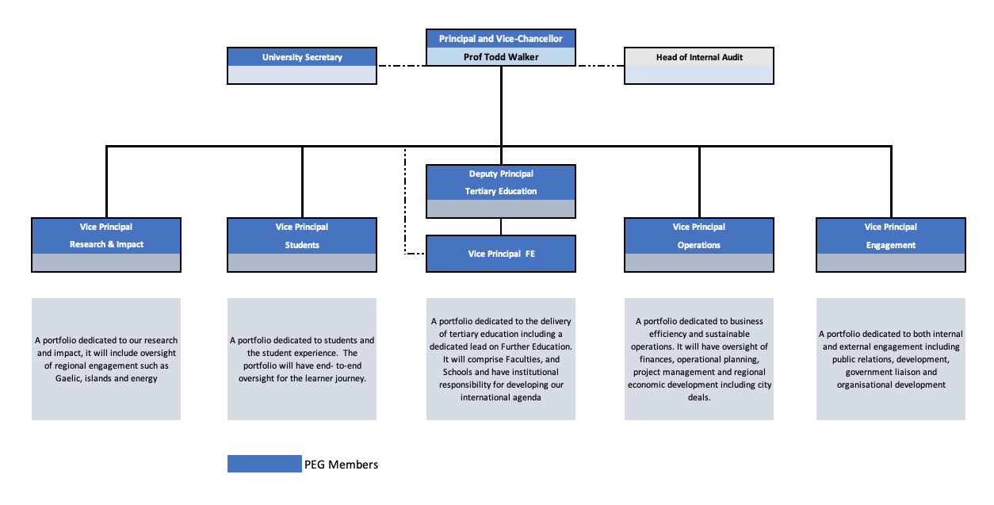
New Portfolios

Slide 8
Achievements – Students
Andrew Jupp, the 2021 University of the Highlands and Islands Chancellor’s Nursing Award.
Emilie Quine has been chosen as a candidate for the Council of Deans of Health's 2021 student leadership programme.
Argyll College UHI student John Frace was named as the university student who has made an Outstanding Contribution at this year’s Herald Higher Education Awards.

Slide 9
Achievements – Staff
Lois Gray, a lecturer and academic lead developer for engineering based at North Highland College UHI, has been named as a national teaching fellow
University’s applied music team has won a collaborative award for teaching excellence.
Appointed a new leader for its School of Health, Social Care and Life Sciences. Professor Brian Williams
Dr Nicola Carey will be joining the university as of Head of the Department of Nursing and Midwifery

Slide 10
Achievements – UHI
The ‘Islands Matter’ collaborative programme has been set up to strengthen the university’s world-leading pan-island research activities and nurture global networking connections.
The £9 million life sciences innovation centre is a partnership project between the University of the Highlands and Islands and Highlands and Islands Enterprise.
Professor Jeffrey D. Sachs, a world-renowned economics professor, bestselling author and global leader in sustainable development, will deliver the University of the Highlands and Islands 2021 annual lecture.

Slide 11

Thank you

