Slide 1

An Economic Perspective on What and Who is UHI for?
Lorna Gregson-MacLeod, Head of Planning and Partnerships
October 2021

Slide 2

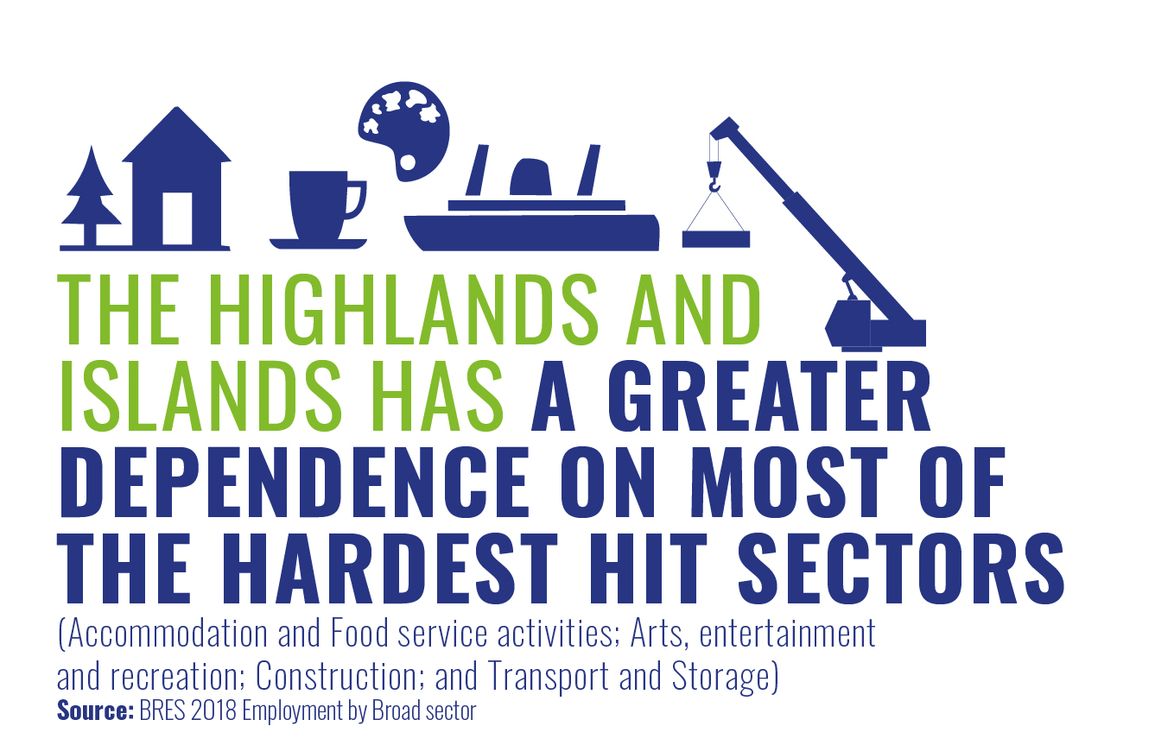

HIGHLANDS AND ISLANDS CURRENT ECONOMIC CONTEXT
Estimated decline in regional GDP estimated at 10.1%* between 2019-2021 and recovery is likely to lag that for Scotland overall (estimated decline 9.2%). Recovery expected to lag Scotland.
Argyll and the Islands, Lochaber, Skye and Wester Ross and Caithness and Sutherland are likely to be the most affected parts of the region
BREXIT
Higher share of:
employment in sectors most exposed to COVID-19 (39% versus 37% nationally)
43% of the population of the Highlands and the Islands live in datazones within the 20% most vulnerable to Brexit in Scotland
The region has a concentration of employment in several sectors which have been most affected by COVID-19 and those sectors which are at risk from BREXIT
Four times as many businesses reported negative impacts on their organisation from Brexit as positive (HIE Business Panel June 2021)
SIGNS of RECOVERY – HIE Business Panel
80% optimistic about their prospects in the next year, up from 75% in February 2020
44% striving for growth; 47% stability
93% confident in their viability over the next 6 months, up from 84% in February 2021
80% optimistic about their prospects in the next year, up from 75% in February 2020
44%
negative
41%
no impact
11%
positive
*This is an experimental methodology developed using GDP and GVA data from the Scottish Government and ONS and is still a work in progress

Slide 3
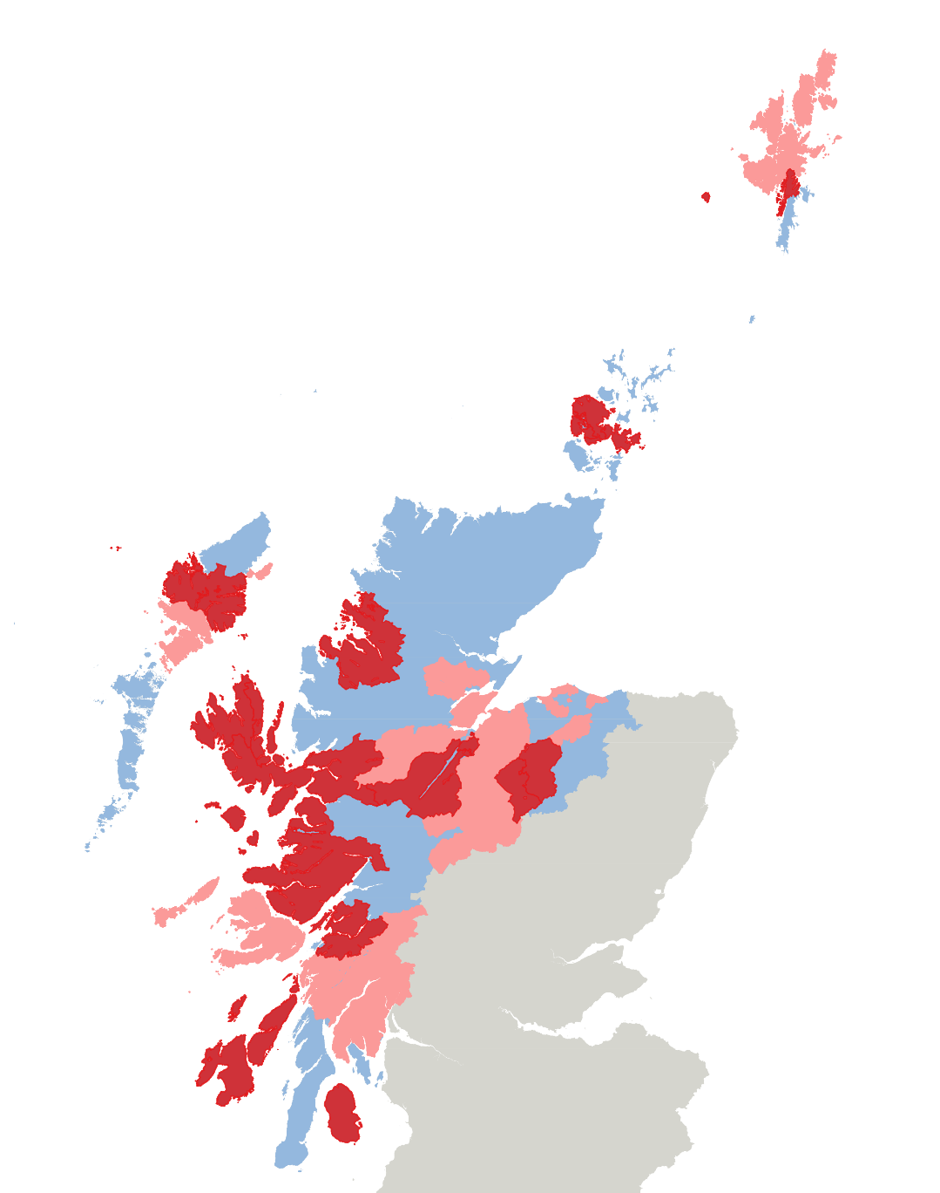
Labour Market Context
Greater rate of increase in number unemployed in region (+50%) than in Scotland (+46%) between Sept 2019 and Sept 2021 and greater increase (+36%) in youth unemployment in region with 1,640 claimants than in Scotland (+32%)
Impact of end to furlough scheme not yet known (7600 estimated to be on furlough end of August)
Labour Market shortages across the region, especially in tourism and hospitality, food processing, construction and transport and logistics.
Shetland: 365
from 1.4% to 2.6%
Areas shaded in pink : Increase in unemployment rate of 100% or over
Areas shaded in red: Increase in unemployment rate of 150% or over
Unemployment Change
July 2019 – July 2021
Caithness and Sutherland: 905
from 3.3% to 4.0%
Orkney: 285
from 1.3% to 2.1%
Inner Moray Firth: 3,775
from 2.4% to 3.9%
Na h-Eileanan an Iar: 590
from 2.1% to 3.8%
Lochaber, Skye and Wester Ross: 915
from 1.6% to 3.8%
Moray: 2,375
from 2.5% to 4.1%
Argyll and the Islands: 1,915
from 2.9% to 5.0%

Slide 4
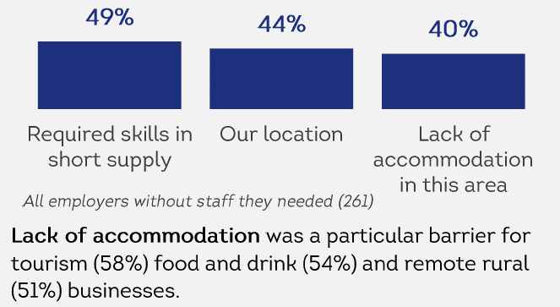
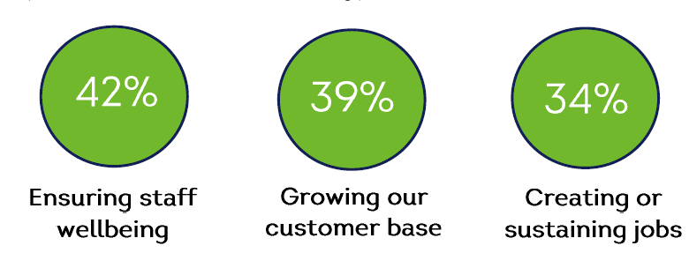
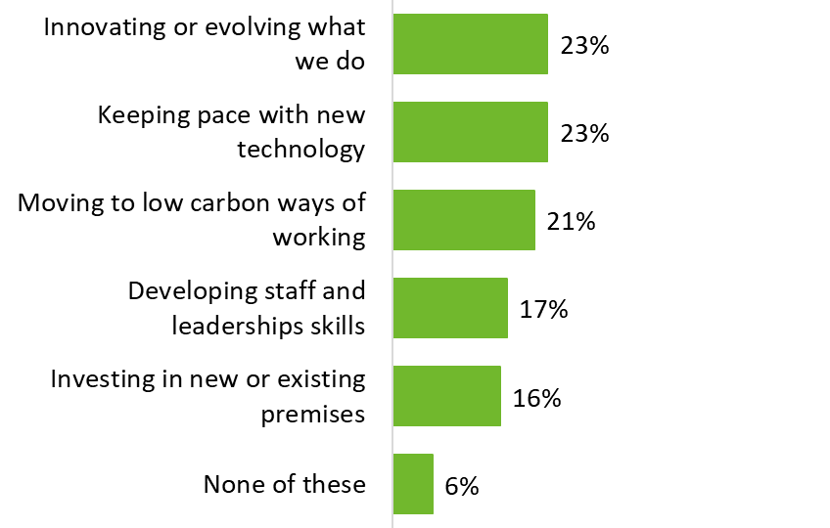
HIE Business Panel June 2021
For those with vacancies, main barriers (top 3):
Employment levels stable for 66% of businesses in the last six months and most currently have the levels of staff they need
Vacancies higher amongst tourism businesses - 30% don’t have the permanent and 42% temporary/seasonal staff they need
Key Priorities:
Actions taken to attract staff:

Slide 5
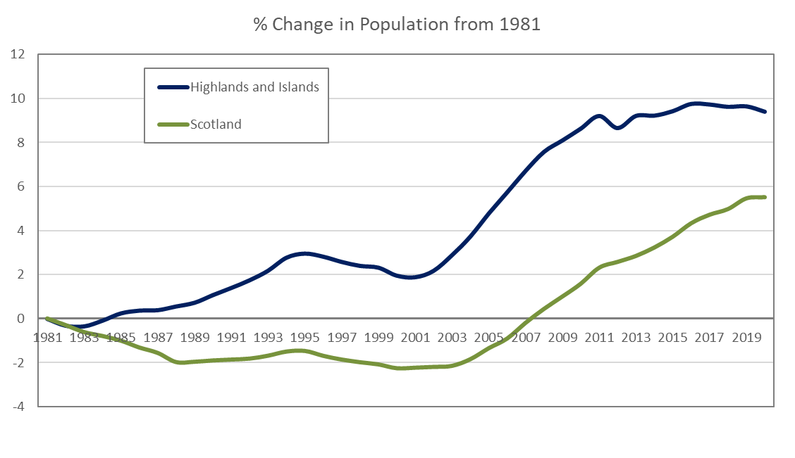
Demographic Change
Positive growth for the region as a whole over the past 40 years but variation within. Caithness and Sutherland, Outer Hebrides and Argyll and Islands with current and forecast decline in population.
The number of people aged 16-29 has decreased by 6.0% in the Highlands and Islands between 2011 and 2020, greater than the decrease in Scotland -3.4%
The share of the population aged 16-29 in the Highlands and Islands in 2020 was 14.3%, compared to 17.3% in Scotland

Slide 6
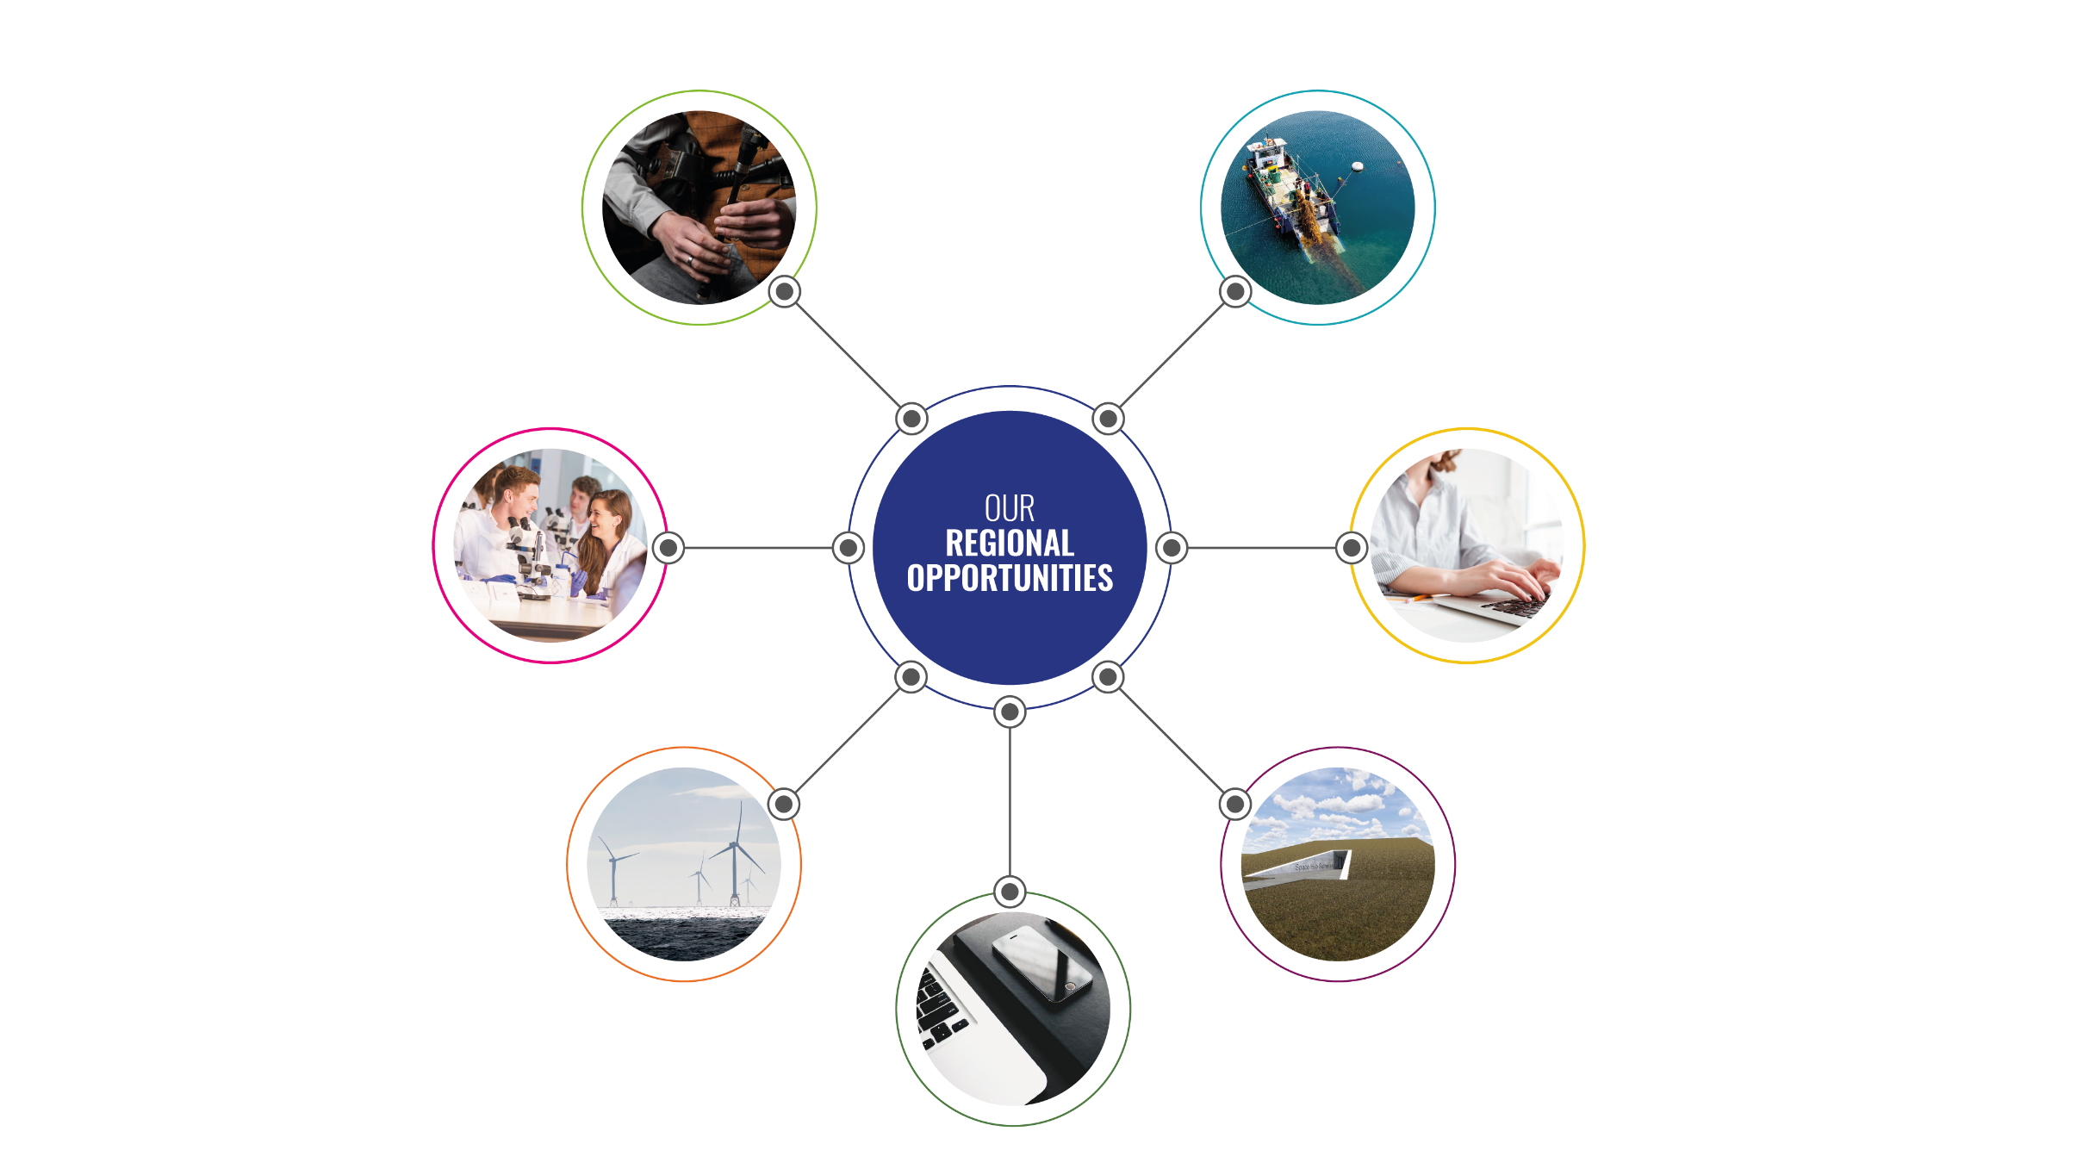
Regional Opportunities
AUTHENTICITY, PROVENANCE AND HERITAGE
BLUE ECONOMY
Key drivers for tourism, creative industries and food and drink.​ Maximising the role of the Gaelic language.
We have a major natural advantage in the green and blue economies:
Aquaculture
Marine biotechnology
Fisheries
Marine tourism
UNIVERSITY OF THE
HIGHLANDS AND ISLANDS
(UHI)
REMOTE AND HOME WORKING
The University of the Highlands and Islands is a key asset, with world-leading expertise in remote learning and specialisms in marine and environmental science.
More remote and home working will provide opportunities to attract more people to live, work, study and invest in the region.​
​
NET ZERO
SPACE/AEROSPACE
Major potential exists in renewables research, development and deployment; development of the Circular Economy; land use and natural capital; and decarbonisation of heat. We’re uniquely placed for net zero supply Chain opportunities and to contribute to national targets. ​Opportunities for more traditional sectors e.g. to establish region as a low carbon destination for tourism sector.
Our geography offers huge opportunities for spaceports and associated space and aerospace supply chain activities.
ADVANCED MANUFACTURING
and TECHNOLOGY
Technology and innovation will accelerate a data and digital driven economy, evolve health care, overcoming geographic barriers and supporting delivery of the just transition to net zero. ​
Notes:
6

Slide 7
What is UHI for?
Regional Model,
Regional Voice Regional Profile
Innovator and leader
International Collaborator
Population and Talent Attractor and Retainer
Economic Contributor and Significant Employer
Key Partner and Influencer
Investor in people, communities, businesses, assets, opportunities
Supporter and developer of Entrepreneurship
Research and Innovation

