Slide 1
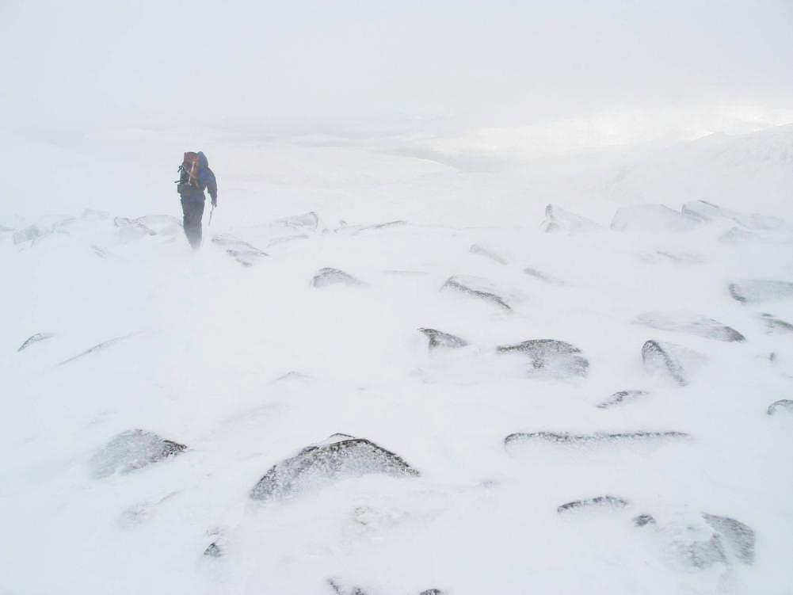
If you want to go fast, go alone

Slide 2
If you want to go fast, go alone
If you want to go far, go together.

