Slide 1
How 'peer' learning and support can help our distance and online learners
Dr Heather Fotheringham
Learning Communities event
15 June 2018

Slide 2

Definition
“People from similar social groupings who are not professional teachers helping each other” (Topping, 1996: 322)

Slide 3


Peer who?
Notes:
PG students, final year students, within years, within subjects, targeted groups (1st years, underperforming or at risk students), one to one, or one to many, or many to many

Slide 4

Notes:
PG students, final year students, within years, within subjects, targeted groups (1st years, underperforming or at risk students), one to one, or one to many, or many to many

Slide 5
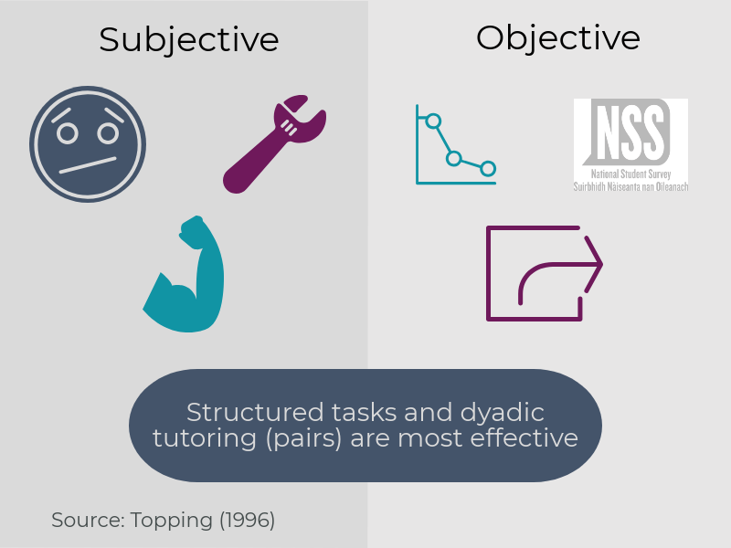

Slide 6
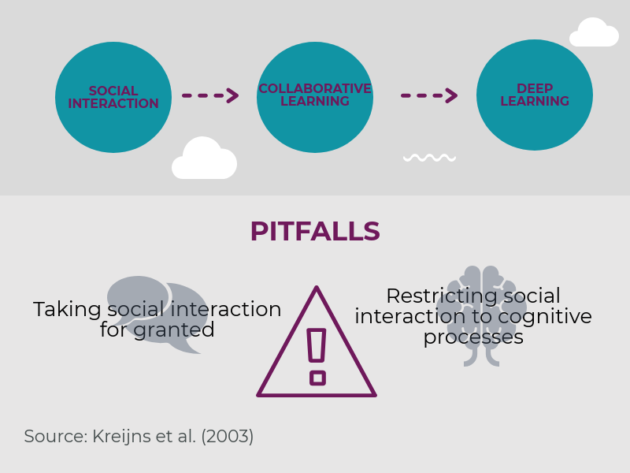
A model of collaborative learning
Notes:
Collaborative and cooperative learning used interchangeably. Really talking about learning in groups: active, small group learning where the student takes responsibility.
Lack of social interaction due to ‘media poor’ environment online vs media rich environment face to face (feedback, cues, senses involved, personalization and language variety). Plus ‘communication anxiety’,
Cognitive processes: Academic task in hand. But social interaction requires trust, warmth, belonging etc.
Solutions: Non-task contexts. Interactivity, instructor’s role (not really solutions, just the antithesis of the pitfalls LOL)

Slide 7
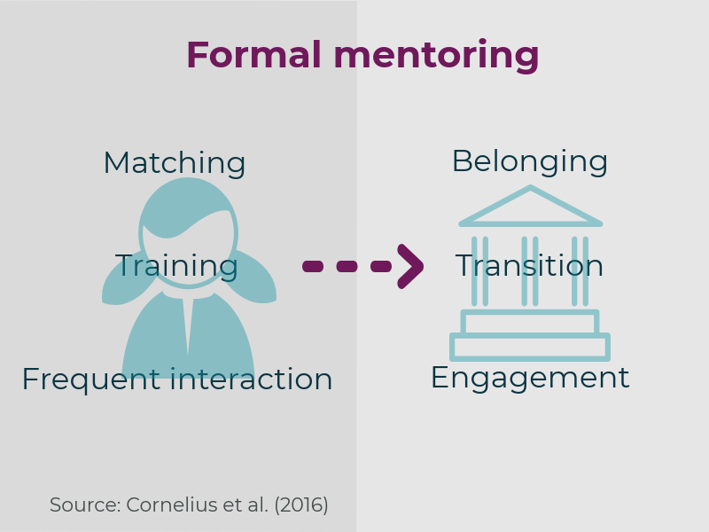
Peer mentoring
Notes:
Lots of resources for this but not so many about online. Or where there are, they just say: we did online peer mentoring- usually emails or discussion boards, and these were the effects

Slide 8

Conclusions

Slide 9
Existing practice
PASS Manchester
http://www.peersupport.manchester.ac.uk/
PAL Bradford
https://www.bradford.ac.uk/student-experience/peer-assisted-learning/
Leicester
https://peermentoring.su.le.ac.uk/

Slide 10

Translation to ODL?

Slide 11
How can the LTA help?
LTA Connect webinars
Events?
Resources?
Please let us know:
  lta@uhi.ac.uk

Slide 12
References
Cornelius, V., Wood, L. & Lai, J. (2016) ‘Implementation and evaluation of a formal academic-peer-mentoring programme in higher education’. Active Learning in Higher Education 17 (3), 193-205
R. Collings, V. Swanson & R. Watkins (2015) ‘Peer mentoring during the transition to university: assessing the usage of a formal scheme within the UK’, Studies in Higher Education, 41 (11), 1995-2010
K. Kreijns, P.A. Kirschner, W. Jochems (2003) ‘Identifying the pitfalls for social interaction in computer-supported collaborative learning environments: a review of the research’. Computers in Human Behavior 19 (3), 335-353
Northrup, P. (2001) ‘A framework for designing interactivity in web-based instruction’. Educational Technology, 41 (2), 31-39
Topping, K. (1996) ‘The effectiveness of peer tutoring in further and higher education: A typology and review of the literature’. Higher Education 32 (3), 321-345

