Slide 1

Creating a learning community for online and distance students
Using student representatives to increase engagement
Welcome and Introductions

Slide 2
HISA Strategic Aim and Objectives
Aim: To create a HISA Class Rep vision for adoption and implementation across UHI and its academic partners.
Key objectives:
Work with SPARQS, NUS and UHI to deliver best possible experience for all class representatives
Ensure training, induction and on-going support for class reps
Support two-way communication between HISA and class reps through the representative structures of HISA
Identify trends and patterns across the university to feed into regional-level discussions to enable university-wide improvement
Develop structures and processes to enable, strengthen and sustain the relationship between class reps, local deputes, SNOs and regional officers.

Slide 3
What we know about class rep systems
HISA mapping exercise identified the following:
Differences among academic partners:
Class rep systems; numbers; training; collating and recording and format of class rep meetings varies across academic partners.
How a class is defined varies between academic partners. Reps cover courses; centres; campuses.
There are some class reps for online courses - but appear to be few and far between
Similarities between academic partners:
Class reps are elected/selected in September and October
The class reps system works the same for FE and HE class reps
The majority of partners hold class reps meetings once per month

Slide 4
HISA CLASS REP VISION – A work in progress
Students voted Class Reps as one of the three themes to be included in the 2018/19 Student Partnership Agreement.
HISA Vice President Higher Education, Sorcha Kirker, Lead Officer
Development of vision and SPA theme will consider:
Recruitment
Processes
Training
Supporting Reps
Closing the feedback loop

Slide 5
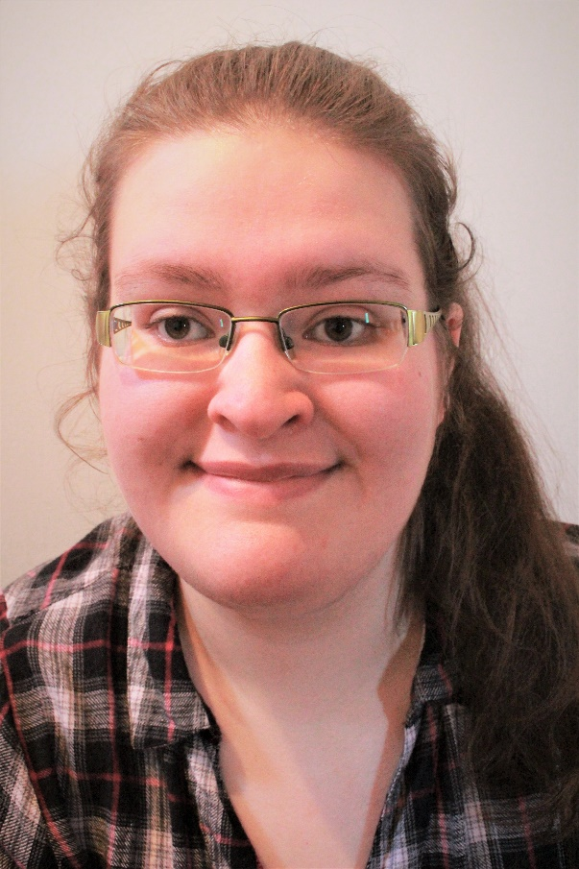
Becky Poyner
My journey as a class representative so far
How I connect with my class?
Where is the support?
How effective is our system?

Slide 6

Florence Jansen
My journey as a class representative so far
How I connect with my class?
Where is the support?
How effective is our system?

Slide 7


Recruitment
Traditionally done in class
Part of HISA’s vision includes holding rep recruitment at freshers – this could still pick up networked reps
HISA intend to create an online video outlining the role of class reps that can be included in inductions (online or face to face)

Slide 8
Process
SEPTEMBER - Recruitment of class reps
Early OCTOBER
Students marked as class reps on SITS via Class Rep Maintenance function on UHI records.
Mid OCTOBER
Programme Leaders requested to check Bridge Report 'STU011 Class Reps by Course' and notify Student Development Officer if any changes/additions are required.
Early NOVEMBER
Student Engagement staff to check Bridge Report 'STU010 Class Reps by Course' for any changes/additions and update local records.
Additional students should be invited to any future training sessions or asked to enrol onto the online training.
New Bridge Reports in ‘Student Engagement’:
STU010_Class_Reps_By_Course
STU011_Class_Reps_By_Course_For_Programme_Leaders
Class Reps
Local Student Engagement staff
Programme Leaders

Slide 9
Training
2016/17: moved to a system of internally run training
2017/18: introduced an online class rep training resource
Training Statistics:
Total number of class reps 17/18 | % receiving face-to-face training | % completing online training | Total % of class reps trained
833 | 52% | 7.5% | 59.5%
Total number of class reps 16/17 | % receiving face-to-face training
955 | 37%

Slide 10
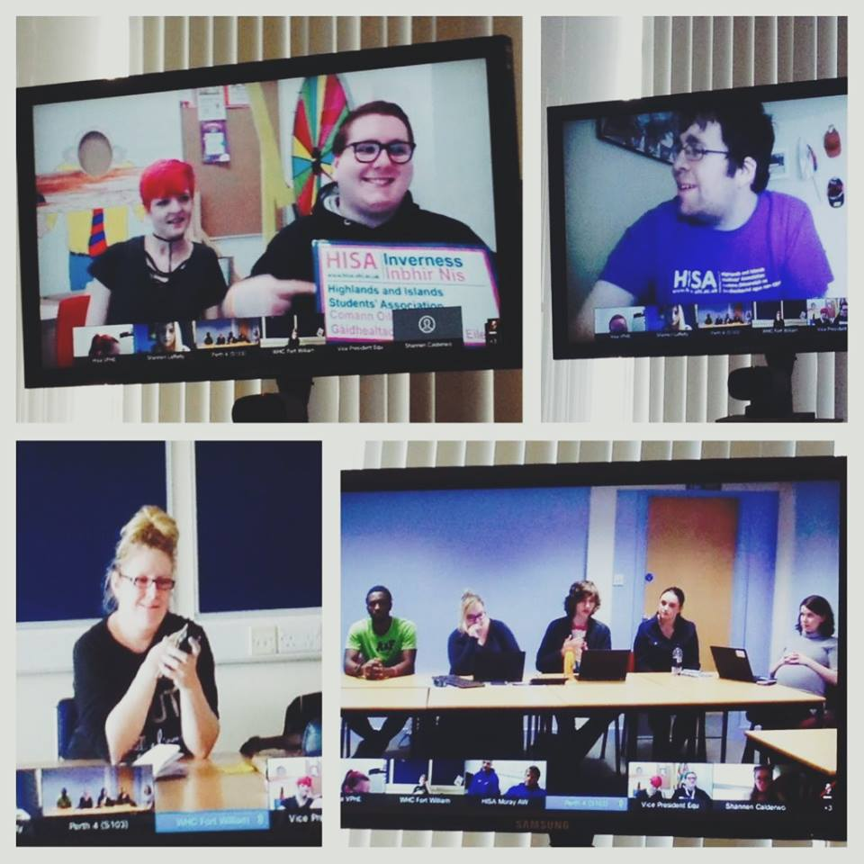
Supporting Reps
- Removing Barriers
Online reps should have the chance to have comparable experiences as face to face students
Make sure local (ie: face to face meetings) are VC accessible
Ensure networked reps are being included in local meetings
Online rep meetings - frequency
- responsibility (FTOs, SNOs)

Slide 11
Closing the feedback loop
Closing the feedback loop is the final stage in ensuring the class rep system is effective – students must know their voice has an impact
ODL students should be given the same opportunities as face to face students to feedback and get input from other students
Online spaces/forums (eg: blackboard spaces) could facilitate this – programme led or HISA led?
Feedback
Identify
the issue
Develop and implement the solution

