Slide 1
Employability and Careers: the Highlands and Islands context
Rosie Alexander
University of the Highlands and Islands
University of Derby
Notes:
I’m going to start by talking a little bit about my professional background and my own context before moving on to talking about some of the theoretixal stuff

Slide 2
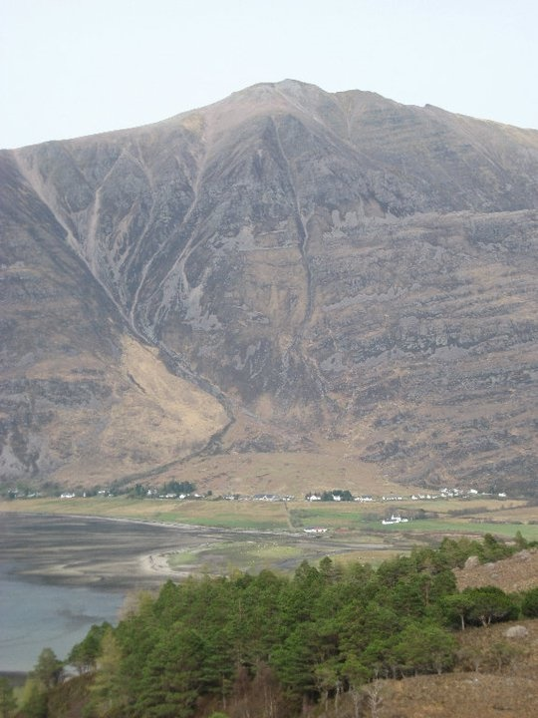
Aims
Employability and careers in HE
Geography
Mobility
Practical implications
Image: presenter’s own

Slide 3
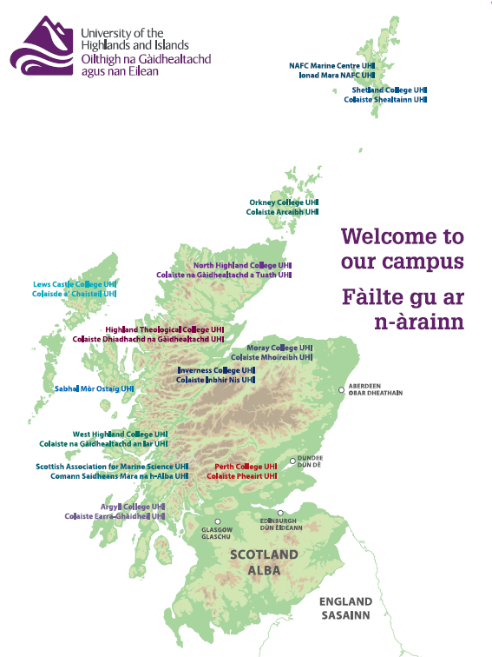
Background
Careers adviser for the university
PhD research on the career and migration pathways of HE students from Orkney and Shetland
Notes:
I’m based [here] I work with students all over this area some of the most remote and rural communities in the UK. Huge geographical differences.
So for me distance and geography are foregrounded in my work.
Question I’d ask you – is / how is geography important in your work? When does place come up as a topic?
For me in this context place is central… this is different to their context, but they need to be thinking about this…. Acknowledge difference to their context
Add a reflective slide (somewhere) on how these issues play out for their students

Slide 4
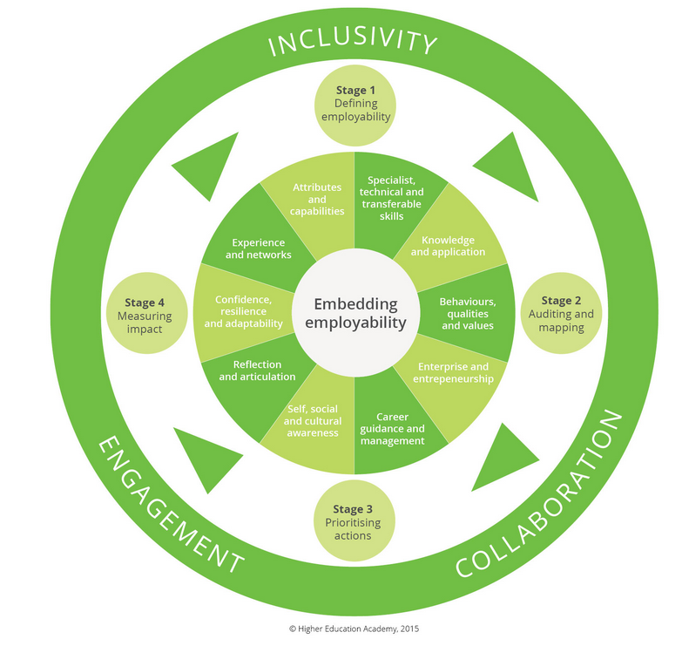
Employability in HE
Employability a key driver for the sector
HEA Employability Framework (HEA, 2015)
HESA statistics DLHE: sector measure

Slide 5
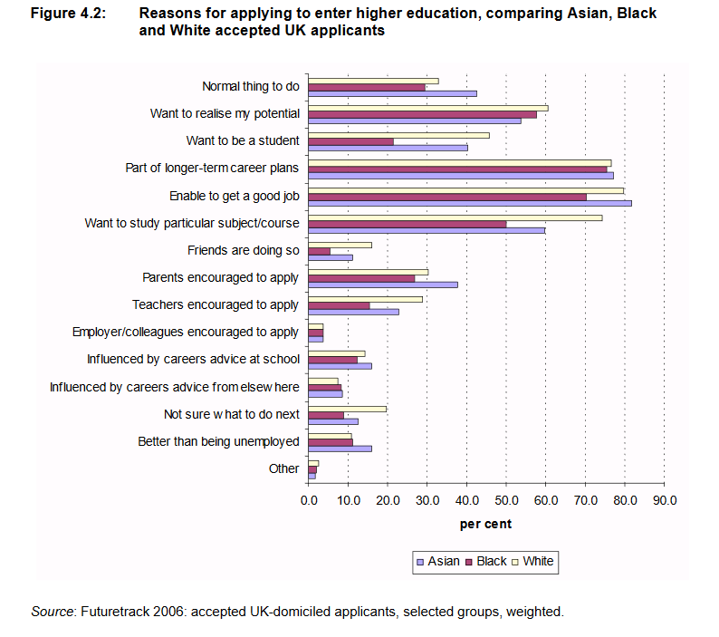
Employability in HE
Employment and careers a key driver for students (Purcell et al, 2008)

Slide 6
Employability & social justice
Graduate Employment varies by:
Subject
Institution
Social class
Gender
Ethnicity
“…it remains the case that the labour market allocates opportunities not just on the basis of factors such as course results and subjects studied but also according to the category of university attended, the age of the graduate, ethnic background and parental education.”
(Purcell et al, 2012: p.xvii)

Slide 7
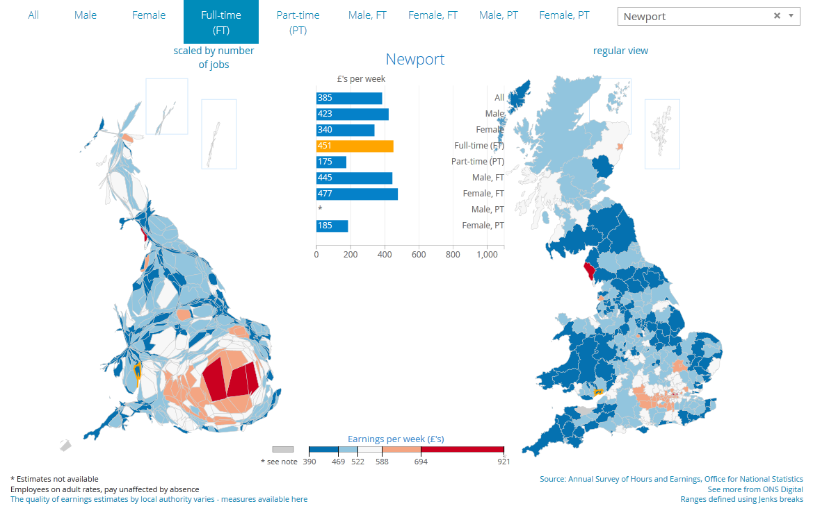
…and Geography?
Graduate labour market: focused in South East
Some regional ‘hubs’ e.g. Aberdeen for engineering
(Ball, 2012)
Map from: ONS (2017)

Slide 8
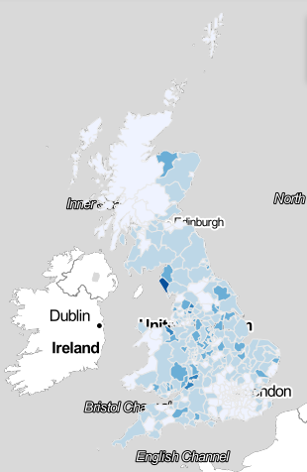
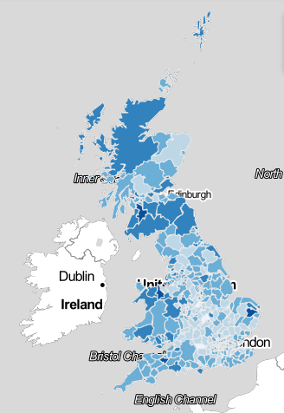
% of employees in manufacturing 2013
% of employees in health 2013
Data from: http://www.neighbourhood.statistics.gov.uk/HTMLDocs/dvc198/index.html

Slide 9

Solution to geographical inequality: mobility
Image courtesy of pixabay.com
Notes:
Which leads on to this… If places are different, can’t we just move? Well, we’ve covered how for young people social, cultural and geographical location can influence career decisions. And when we become adults this notion that we are ‘free to move’ is not really true….In fact I’ve just written a piece about how the narrative of free career choice, and free place choice are part of neoliberal discourses which prioritise the individual and position the individual as freely making choices. Doesn’t tend to recognise structural constraints and context.

Slide 10

Mobility: the moral imperative
“Graduates need to consider where their best long-term interests lie and plan accordingly; this might entail considering jobs some distance from home or even moving closer to where more graduate jobs exist” (Pennington et al , 2013: 10).
Image courtesy of pixabay.com

Slide 11
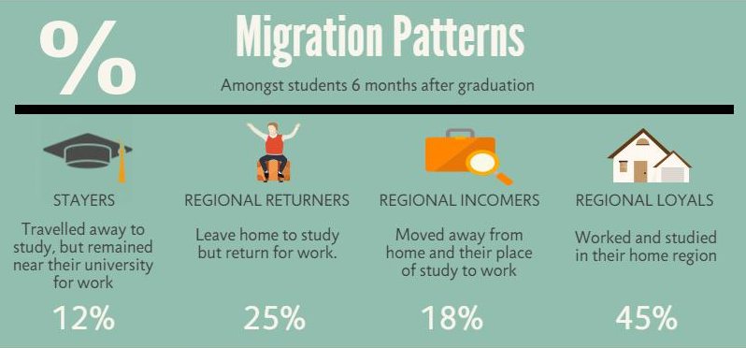
However, mobility is complex…
Image and statistics from Charlie Ball: https://highpeakdata.wordpress.com/author/highpeakcharlie/
Notes:
Quiz style- hide and reveal
This is regional and regions are quite large.

Slide 12

Mobility in the Highlands and Islands
40% of Orkney and Shetland graduates are back in the islands six months after graduation.
(Alexander, 2015)
76% graduates from University of Highlands and Islands employed in the area
(University DLHE statistics)
Image courtesy of pixabay.com
Notes:
Image courtesy of pixabay.com

Slide 13

Interrelates with other elements of disadvantage
Mobility varies by:
  Gender
  Ethnicity
  Class
  Family background
  Qualification level
Mobility capital unevenly distributed (Kaufmann et al, 2004)
Geography becomes a social justice issue (Soja, 2010; Alexander, forthcoming)
Notes:
***check

Slide 14
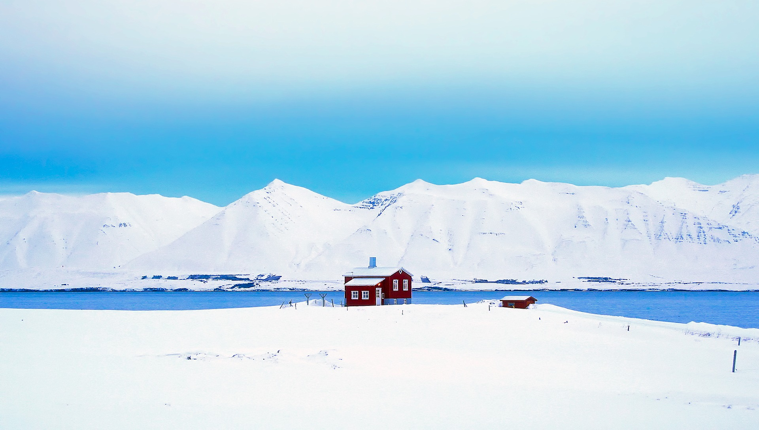
Practical implications for Higher Education
“What can I do with my degree….?”
Image courtesy of pixabay.com
Notes:
Do you want to move? What would it be like?
Why do you want to move / stay? What do you imagine?

Slide 15
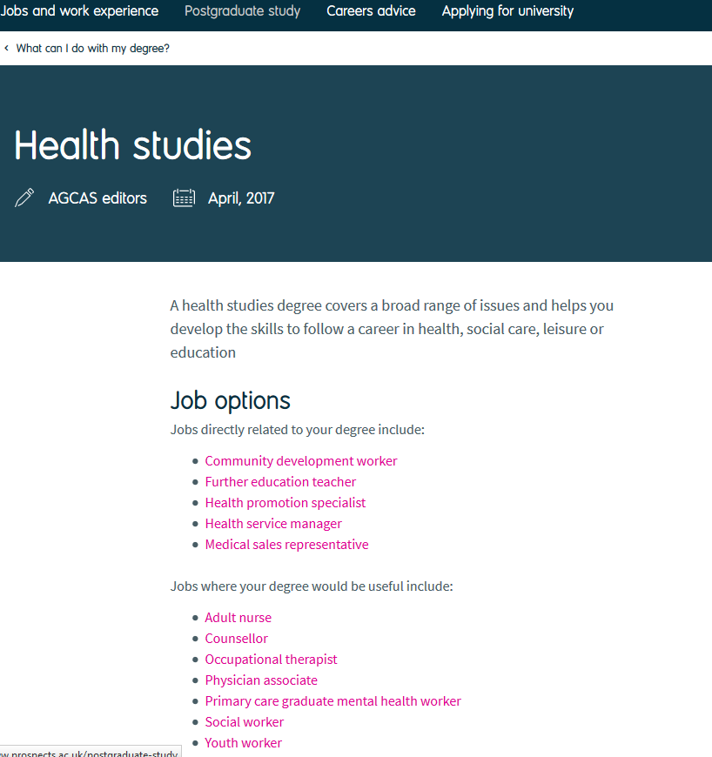
The status quo
Students’ motivation for HE is career driven
Students may not want or be able to move
Resources give implicit message that you have to move

Slide 16
Institutional, service and staff responses
Promote mobility for greater career choice
Promote location as a valid choice
Mobility programmes (domestic)
Awareness raising of opportunities elsewhere
Networking opportunities
Funding opportunities
This is not a neutral choice
In practice normally a combination of the two…
Holistic approach to career development
Locally focused services
Enterprising approach to career development
Political lobbying
(Alexander, forthcoming)
In practice normally a combination of the two…

Slide 17


Mobility and careers: ethical dilemmas…
“What can I do with my degree…?
“Can you move….?”
Images courtesy of pixabay.com

Slide 18
Practical implications
When working with careers and employability we need to:
Raise awareness of labour market geographies
Encourage critical reflection on career development and geography
Encourage reflection on attitudes to place and mobility
Explore wider life choices and circumstances

Slide 19
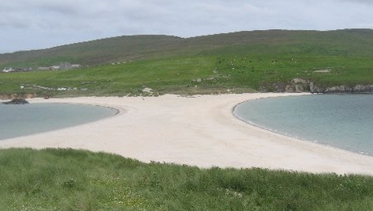
Implications for the university
Our geography is central to our mission as a university.
Geography should also be central to the way we all think about employability and careers.
“The university for all of our region” – Strategic Theme 1
“Our worldwide reputation… enriched by the people, natural environment, economy, culture and heritage of our region and its communities” – Strategic Vision
Image: presenter’s own

Slide 20
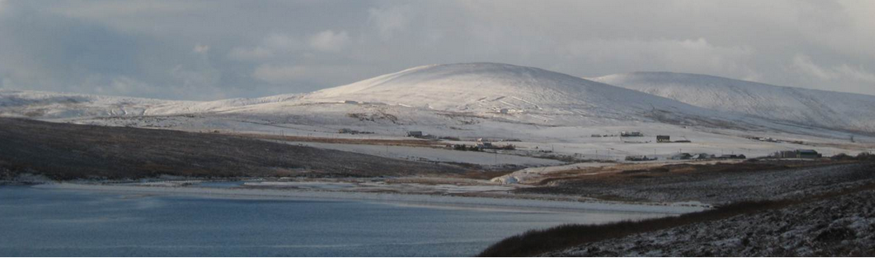
Thank you
Email: rosie.alexander@uhi.ac.uk
Website: rosiealexander.wordpress.com
Twitter: @rosie148
Image: presenter’s own

Slide 21
References
Alexander, R. (2015) A case study of higher education pathways of rural students. Graduate Market Trends Autumn, 2015, 14-15. Retrieved from:http://www.hecsu.ac.uk/current_projects_graduate_market_trends.htm. Accessed 15 Jan 2014
Alexander (2017) Social justice and geographical location in career guidance, in Hooley, Sultana and Thomsen (eds) Career Guidance for Social Justice: Contesting Neoliberalism. Routledge, London.
Alexander (forthcoming) Graduate Destinations: The Geographical Dimension, in Christie and Burke (eds) Understanding Graduate Careers: Research Policy and Practice in Context. Routledge: London
Ball, C. (2012) Regional overview of graduate employment What do graduates do? HECSU/AGCAS p.4
HEA (2015) Employability Framework. Available from: https://www.heacademy.ac.uk/knowledge-hub/framework-embedding-employability-higher-education
Hooley, T. & Sultana, R. (2016) Career guidance for social justice. Journal of the National Institute for Career Education and Counselling, 36, 2-11 doi:10.20856/jnicec.3601
Kaufman, V.; Bergman, M. M. & Joye, D. (2004) Motility: Mobility as Capital International Journal of Urban and Regional Research 28(4) pp.745-56
ONS (2017) Annual Survey of Hours and Earnings: 2015 Provisional Results. Retrieved from: https://www.ons.gov.uk/employmentandlabourmarket/peopleinwork/earningsandworkinghours/bulletins/annualsurveyofhoursandearnings/2015provisionalresults
Pennington, M; Mosley, E & Sinclair, R (2013). AGCAS / AGR graduate success project: An investigation of graduate transitions, social mobility and the HEAR. AGCAS: UK. Retrieved from: http://www.agcas.org.uk/articles/694-Graduate-Success-Project-AGCAS-findings-launched
Purcell et al (2008) Applying for Higher Education – the Diversity of career choices, plans and expectations. HECSU: Manchester. Retrieved from https://www.hecsu.ac.uk/assets/assets/documents/Applying_for_higher_education.pdf
Purcell et al (2012) Futuretrack Stage 4: transitions into employment, further study and other outcomes. HECSU: Manchester. Retrieved from https://www.hecsu.ac.uk/assets/assets/documents/Futuretrack_Stage_4_Final_report_6th_Nov_2012.pdf
Soja, E. W. (2010) Seeking Spatial Justice London: University of Minnesota Press

