Slide 1


ENGAGING STUDENT REPS
SORCHA KIRKER – HISA VPHE

Slide 2
WHAT ARE STUDENT REPS?
Also known as course, or class representatives
They exist to represent a defined group of students (E.g. a year group, or a class), to the college staff and HISA
They are an essential communication link to the students

Slide 3
WHAT DO STUDENT REPS DO?
They are the student voice
  They represent the students to college staff and HISA
  They feed back to staff on what students have to say about their experience, and on issues that students may be facing on their course.

Slide 4
WHAT DO STUDENT REPS DO?
They provide both negative and positive feedback
  It is important not only to provide constructive criticism, but to let staff know what they are doing right
They help to improve the student experience
  This may be the learning experience, but it can also be improvements to students experience in general, e.g. social opportunities for students, facilities at the campus
They feedback to the students
on any actions taken

Slide 5
WHAT DO STUDENT REPS DO?
Attend Course Committee Meetings
  Student reps attend meetings with module leaders on course progression
Sit on College Committees
  e.g. College management committee, Student Engagement Group, Learning and Teaching Committee
Involvement in External Reviews
  Where the institution is being
reviewed by an external panel

Slide 6
WHAT DO STUDENT REPS DO?
They feed into a much larger picture, engaging with the institution’s Students’ Association and beyond – the National Union of Students (NUS)
  E.g. Taking part in democratic conferences held by the NUS, in which they vote on actions to help students nationally

Slide 7
WHY ARE STUDENT REPS IMPORTANT?
If staff are making decisions which will affect students, then students should be involved
  Student reps bring the student voice to these decisions, and staff should make an effort to include them
Students aren’t always forthcoming to staff members
  Course reps provide a crucial link in the communication between students and staff

Slide 8
WHY ARE STUDENT REPS IMPORTANT?
They have an important role in promoting student engagement
  They are in the class with the students and can promote the importance of student involvement in the feedback system

Slide 9
HOW DO STUDENT REPS WORK?
Staff
Student Reps
Students in class
Changes
To
Students
Experience
Changes
To
Learning
And
Teaching Environment

Slide 10
WHAT KIND OF ISSUES CAN STUDENT REPS FEEDBACK ON?
Specific issues with a lecturer or teacher
Assessment feedback
Student events
Teaching methods
Student Reps
Improvements to the campus
Resources
Extra support for students
The curriculum

Slide 11
HISA AND STUDENT REPRESENTATIVES
Reps meet regularly throughout the year as a group to discuss issues with college staff and the Students’ Association (HISA)
HISA Deputes and Local Officers normally attend the rep meetings to gather student feedback, and to update the reps on what the Students’ Association are working on
The officers will also promote activities, events and opportunities to the Student Reps

Slide 12
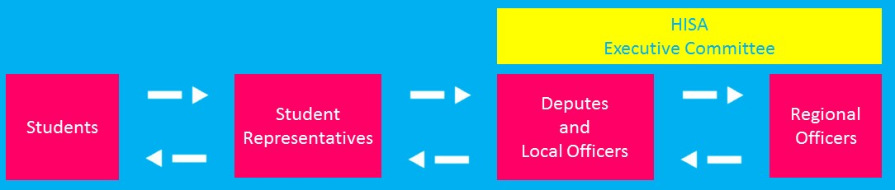
HISA STRUCTURE
13 campuses across the region
18 Depute Presidents and Local Officers communicating from Student Reps and students, to the Executive Committee
Regional Council - The coming together of the executive, and student representatives from every campus

Slide 13
HOW WE WORK
STUDENTS
STUDENT REPS
HISA DEPUTE/LOCAL OFFICERS
HISA EXECUTIVE COMMITTEE
NATIONAL UNION OF STUDENTS (NUS)
HISA can raise issues at a national level through NUS. Student reps can attend NUS conferences and events with HISA
Students report issues to student reps, to raise with staff or HISA
This cycle then works in reverse - all organisations feed back until it reaches the students
Student reps can also sit other committees, as well as attend events (E.g. Regional Council)
Student reps provide feedback to their local HISA Depute President who provide support locally, or will raise it with the HISA Executive

Slide 14
CLASS REP MAPPING PROJECT (2016)
Necessary as every AP has a different Student Rep System due to the unique nature of the partners:
  Terminology
  Meeting structure
  Number of reps
  Level of engagement
  Size of system
  Staff value

Slide 15
CLASS REP MAPPING PROJECT (2016)
Findings:
Attendance patterns similar – high at the beginning, low at the end
Systems vary in size
Variation in election processes
NAFC had no system (it does now)
HTC + SAMS = HE only
Variation in meetings reps are invited to
Variation in amount of rep meetings and the structure
Variation in training provided
APs definition of ‘class’
Inconsistency in officer
involvement

Slide 16
STUDENT REP INVOLVEMENT WITH HISA
Regional Council
  Every Academic Partner is assigned 4 spaces for Student Reps to attend this event with their Local HISA Officer
National Events
  Attendance at NUS Scotland Events (E.g. NUS Scotland Conference)
  Attendance at sparqs events
National Recognition
  Student Rep from LCC won College Student Rep of the year in the sparqs awards 2017
  Student Rep from Orkney
  nominated at the same event

Slide 17
STUDENT REP INVOLVEMENT WITH HISA
Student Reps on NUS Scotland Committees
  3 Student Reps elected to separate NUS Scotland Committees:
    - NUS Scotland Women’s Committee
    - NUS Scotland Disabled Students’ Committee
    - NUS Scotland LGBT+ Committee

Slide 18
WHAT WE ARE GOING TO WORK ON
Student Partnership Agreement 2018-19 – ‘Class Reps’ theme
Enhancement Themes Project
Engagement with Distance Learners and Networked Students
Re-map Student Rep systems across UHI
Train the Trainer

Slide 19
HOW CAN STAFF ENGAGE MORE WITH STUDENT REPS?
Promote engagement with the Student Rep system at your Academic Partner
Support students in their role
  Give them time at the beginning/end of class to feedback to their fellow students
  Ask them if there were any points raised at the meeting that you should be aware of
Help recruit reps at the start of the year
Make students aware of who
their Student Rep is

Slide 20
HOW CAN STAFF ENGAGE MORE WITH STUDENT REPS?
Ensure Student Reps are invited to the appropriate meetings (E.g. Course Committee Meetings)
  Support them in their attendance (go through the meeting papers, ask if there is anything they don’t understand, ensure they are clear on their role at the meeting etc.)
Ensure that Student Reps are involved in any feedback processes to do with your class
  Seek their advice/help if you wish to gather any student feedback

Slide 21
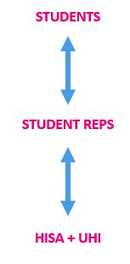
HOW CAN STAFF ENGAGE MORE WITH STUDENT REPS?
Get Student Reps to update the students on any work
you have done based on student feedback (closing the
feedback loop)
  It is crucial that students are made aware of any
  changes you make, so that they know their feedback
  has been taken onboard)
Communicate! Communicate! Communicate!

Slide 22
ANY
QUESTIONS?
☺

