Slide 1
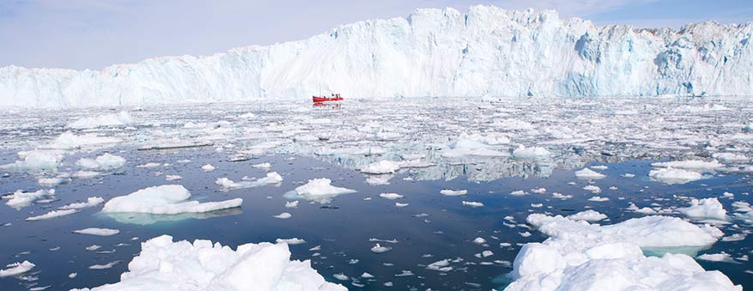
Preparing for uncertainty? Investigating the development of criticality among masters students
Cameron Graham, Lecturer Department of Learning & Teaching Enhancement,
Edinburgh Napier University
Doctoral Researcher, University of Glasgow

Slide 2
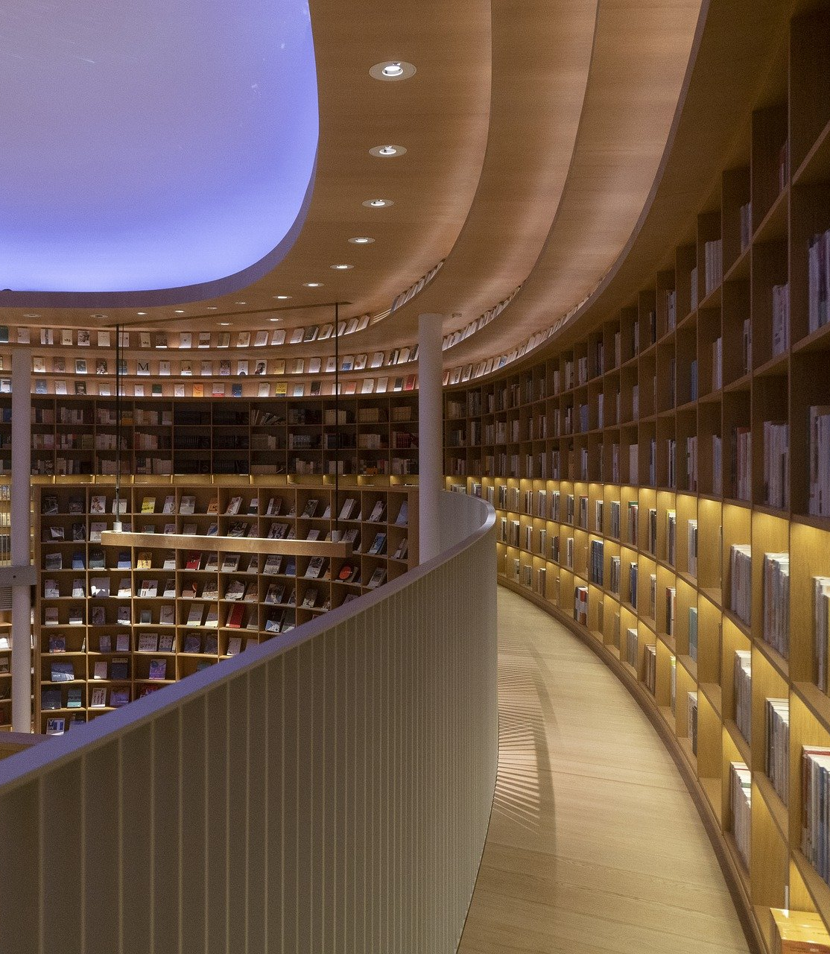
Research Question:
How is criticality conceptualised, developed and applied by students in Masters study?

Slide 3

Context
Critical thinking:
Is one if not the main purpose of Higher Education (Barnett, 1997; Danvers, 2016).
Is a ubiquitous and widely cited concept yet its definition is often contested (Dunne, 2015).
Development among students is largely assumed and under-researched (Johnston et al, 2011).
© Coldwarsteve, 2020
As an attribute, skill and disposition in graduates, it is more important now in a time of increasing complexity, uncertainty and societal change than ever to prepare individuals to critically engage with their world (Barnett, 1997; 2000; Barnett & Davies, 2015; WEF, 2016).
Internationalisation of HE–international students often face critical thinking related difficulties, often compounded among Asian students in adapting to new academic environment and instruction language (Fakunle, et al. 2016; Chen, 2017; Zhang, 2020).

Slide 4
“the world's gonna be on fire and burning and no one says nothing about it” Research Interview Participant, 2017

Slide 5
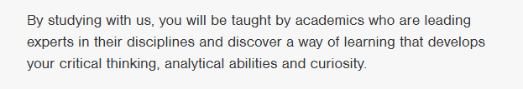


Slide 6
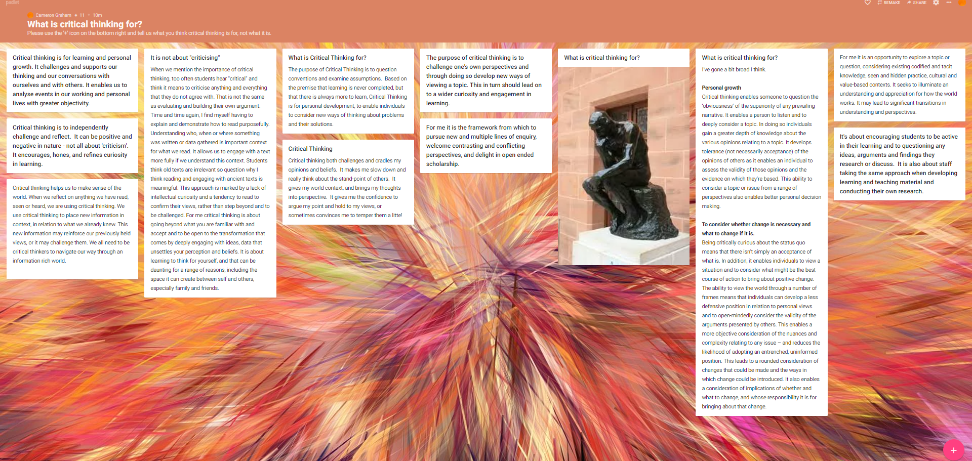
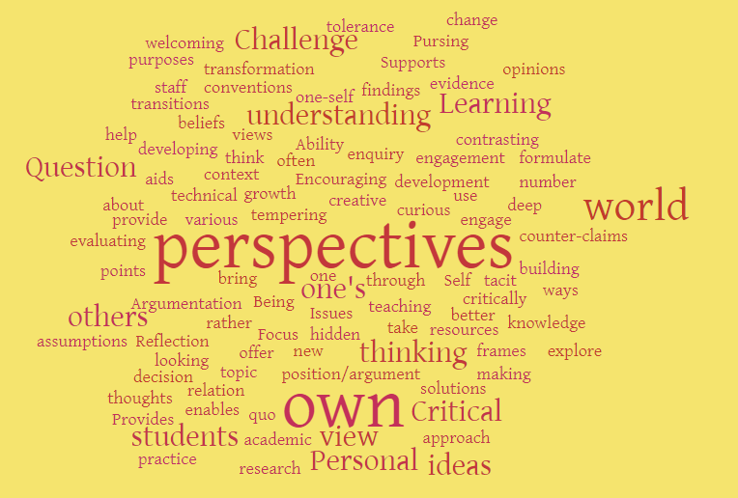
What is Critical Thinking for?
Themes:
Cognitive, argumentation
Personal, individual
Technical, educational
Social, political

Slide 7
Critical Thinking Definitions Ennis “Reflective and reasonable thinking that is focused on deciding what to believe or do” (1985:45) Burbules & Berk “to be more discerning in recognising faulty arguments, hasty generalisations, assertions lacking evidence, truth claims based on unreliable authority [and] ambiguous or obscure concepts” (1999:46) Brookfield “speaking truth to power…to detect and resist ideological manipulation, and to lay bare the abuses of power” (2015: 530)

Slide 8
Shifting focus
Is a focus on critical thinking within HE enough?
Davies and Barnett (2015: 14) argue that ‘criticality’ “is a term deliberately
distinct from the traditional expression ‘critical thinking’, which was felt to
be inadequate to convey the educational potential that lies to hand”.

Slide 9
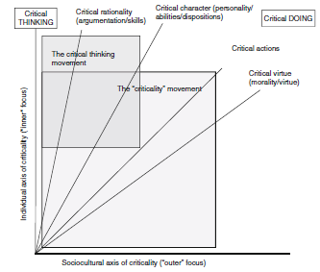
Critical Thinking > Criticality
Criticality
Broader concept than critical thinking, incorporating thinking, reflecting and acting critically (Barnett, 1997).
Expands critical thinking from a focus on the individual and their skills and dispositions to thinking critically, to considering individuals’ place in the world (e.g. ‘responsible citizenship’), placing emphasis on taking actions resulting from thinking and reflecting critically (Davies, 2015).
The critical thinking and criticality movements (Davies, 2015)

Slide 10
Theoretical Approach
Criticality
Criticality can be considered “…a function of collective questioning, criticism, and creativity, it is always social in character, partly because certain of these activities (particularly thinking in new ways) arise from an interaction with challenging alternative views”.
(Burbules and Berk, 1999:62)
“criticality, in contrast to critical thinking is not something that is simply ‘switched on’ or engaged, when a specific topic that requires critical thinking emerges. Rather, criticality as critical being, is inexorably embedded in our everyday activities and experiences, regardless of how mundane they may appear”
(Dunne, 2015: 92)

Slide 11
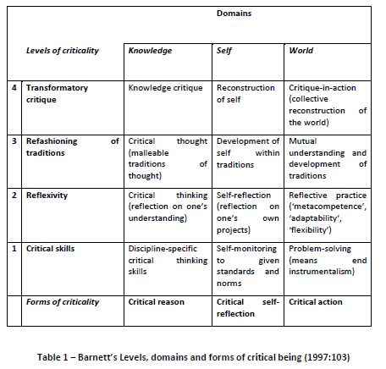
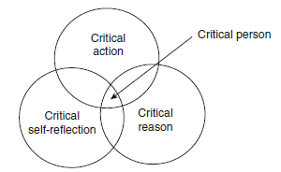
Theoretical Approach
Barnett (1997) defines his concept of critical being as encompassing:
critical reason, critical self-reflection and critical action.
Barnett’s three domains of expression of critical being, exist in an interdependent,
fluctuating and evolving relation within the three domains of knowledge, self and
world, which are themselves dynamic and interconnected (Barnett, 1997).
Notes:
Four levels of criticality, three domains and three forms of criticality – complex and abstract model that needs empirical investigation

Slide 12

Research Design
Phase One – Questionnaires – October-December 2017
15-minute, self-completion questionnaire
Administered at start of academic session – post-induction
Phase Two – Semi-structured, in-depth interviews – December 2017 onwards
Students
Student respondents opting in via survey
Contacted by email
One interview –mid-academic session
Staff
Academic staff, programme/course leaders from selected courses sampled and contacted by email
One interview – post-academic session

Slide 13
Questionnaire Respondent Profile
293 Masters students
13 Masters courses
3 Universities
Questionnaires
Sample | 293 Masters students | 3 universities | 13 Masters courses
 | Total | Females | Males
Age | Mean = 26.64 | Min age = 19; Max age = 52
 | 19-23 = 128 (44.1%) 24-30 = 109 (37.6%) 31-52 = 53 (18.1%) 3 missing cases | 19-23 = 107 (47.3%) 24-30 = 79 (35.0%) 31-52 = 40 (17.5%) | 19-23 = 21 (32.8%) 24-30 = 30 (46.9%) 31-52 = 13 (20.3%)
Sex | M = 64; F = 229 | Min age = 19; Max age = 52 Mean age = 26 | Min age = 22; Max age = 49 Mean age = 26
Nationality | 41 nationalities Africa = 6 (2.1%) Asia = 137 (46.9%) Central & South America = 5 (1.7%) Europe = 131 (44.9%) North America = 13 (4.5%) 1 missing case | Africa = 1 (0.4%) Asia = 117 (51.3%) Central & South America = 2 (0.9%) Europe = 100 (43.9%) North America = 8 (3.5%) | Africa = 5 (7.8%) Asia = 20 (31.3%) Central & South America = 3 (4.7%) Europe = 31 (48.4%) North America = 5 (7.8%)
English as First Language | English = 105 (41.2%) Not English = 150 (58.8%) 38 missing cases | English = 78 (40.0%) Not English = 117 (60.0%) | English = 27 (45.0%) Not English = 33 (55.0%)

Slide 14
Findings from Questionnaires
6% Highly developed;
33% Well developed;
41% Unsure;
15% Developed;
2.7% Not well developed

Slide 15
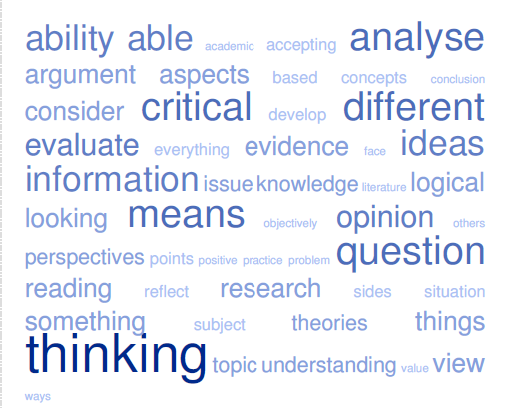
Findings from Questionnaires
From:
‘being a dissident’ and being able to ‘evaluate both up and down sides’,
To:
having ‘…the ability to think, to question, to challenge something. The courage to think differently’, and
‘Questioning, analysing and critiquing the world around you.’
Critical Thinking Conceptualisations
Critical Thinking Definitions

Slide 16
Findings from Questionnaires
Significance @ <0.05 level (.000) [Paired Samples t-test]
Notes:
88.7% say CT is important or very important for Work/Career – 6.5% unsure, 4.7% unimportant
61.1% very important
70.3% say CT is important or very important for Daily Life – 20.8% unsure, 8.9% unimportant
- 28.7% very important

Slide 17
Findings from Questionnaires
Sosu, E. (2013) The development and psychometric validation of a Critical Thinking Disposition Scale. Thinking Skills and Creativity, 9, pp. 107-119.
Notes:
These are sum scores from Sosu’s CTDS scale
UK students (n56) scored highest in terms of disposition at 53.8% compared with even numbers of students (n33) in both the China (26.8%) and Other (55.0%) also categorised with a high critical disposition from their summed scores.
Scoring in the moderate category is quite differently distributed with Chinese students (n74, 60.2%) predominantly scoring with a moderate disposition, while UK students followed (n43, 41.3%) with only 12.5% fewer students scoring moderate over high disposition, with 31.7% of Other students (n19) scoring moderately overall

Slide 18
Overview of findings arising from student interviews:
Role of dialogue – especially international, intercultural dimension
Formal –class debates, presentations, group work
Informal – tutorial tasks, between and outside classes - CoP
Dialogue as ‘internal feedback’ (Nicol, 2019) through comparing perspectives, views on topics etc.
Engagement with difference
Dialogue, Diversity, Differing Perspectives
Students’ epistemological beliefs = reticence to challenge authority
“not my place to criticise policy” (UK, Midwifery Student)
Academic Literacies
Role of structure and writing “what tutor wants” (Chinese, Education Students) – conformity, mimicking criticality
Rules of the game– “rules of writing an academic paper” (US, Politics Student)
Inverted study processes
Limited and isolated application of criticality
Notes:
Role of dialogue – especially international, intercultural dimension

Slide 19
Findings from student interviews
Language & Cultural Distance (for NNES)
Impact on understanding – lectures, reading etc.
Need to translate and time implications.
Adaptation to context and expectations
Explicitness of critical thinking concept in courses
Strong focus on critical thinking and related aspects – critical analysis, evaluation etc., though limited definition or explanation of this to students – understanding assumed.
“they assume we know the definition of critical thinking” (Taiwanese, Adult Ed Student)
“it's strange that no-one exactly tell us what critical thinking is, they just emphasise critical thinking every time we have a task and they say 'we will develop some controversial interesting arguments' but no-one say how should we do that, how can we achieve to develop controversial and interesting arguments?” (Chinese, Education Student)

Slide 20
Findings from student interviews
Impact of first degree and life and work experience
Habits of mind – ‘one answer’ vs no correct answer
‘Field changers’ – alignment of previous degree with current masters and perceived level of critical thinking and further development of this.
Influence of previous teaching and learning mode
Memorisation and rote learning vs Active, inquiry-based learning
Role of academic literacies – rules of the game (Johnston, et al. 2011)
“I feel like I have this sort of unfair advantage that I learned the rule book really early...it’s such a formula to write papers” (Political Communication Student)
Role of assessment and language– textual bias (Lillis, 2007)
Validity of written assessment as means of evaluation of critical thinking questioned – and limited space to articulate points and arguments within assignments.

Slide 21
Findings from student interviews
Internationalisation
Learning with peers from other cultures and their experiences, values and beliefs
Role of Dialogue
International aspect brings “a massively broad perspective to things” in discussion (UK, Education Student)
Diverse classes with “people from all over the world with different understandings and multiple perspectives” provide “good opportunity” (Canadian, Public Policy Student) for students to develop critically – “different perspectives of students…very eye opening” (Chinese, Education Student)
Tutorials - space to share and provide alternative perspectives
Diversity and confrontation with difference in views, opinion, experience and challenging of perspectives.

Slide 22
Key findings from Staff Interviews
Language issues highlighted and unfamiliarity with critical thinking:
“I think at the start, for most of them this is a new idea, you know, and so you have to introduce it to them, you have to give them permission to do it...you have to, in a sense, tell them this is what we do here.” (Education, PL)
Critical thinking level and ability:
“[In terms of critical thinking] I mean, to be honest, on average our honours students are better than our masters students” (Politics, PL)

Slide 23
Staff Interviews
Role of programme in developing criticality:
“There is a sort of vocational aim driving behind the course...so we're anticipating that they are going to be going to be working somewhere in an inter-governmental organisation or a ministry of education or local authority or somewhere like that. So you know I think there's a very clear idea going through the programme that…they're gonna be applying these reasoning powers and these sort of analytical skills to some sort of a decision or a policy debate in the future which will have genuine implications”. (Social Science, PL)

Slide 24
Staff Interviews
Role of programme in developing criticality:
“I mean that's the idea...that is precisely my interpretation...I mean critical thinking, as I said, in terms of literature is quite narrow but is more aiming to be able to link that to…how they do work or how they consume media, how they act as citizens or...activists or whatever…… I feel like I'm developing their hardware, software changes all the time, they can learn the software on the job, but I'm developing their hardware and you know if I do a job on developing their hardware that's going to serve them for lifetime...” (Politics, PL)

Slide 25
Staff Interviews
Role of programme in developing criticality:
“[I feel] higher education should give you...I mean if you do a very vocational course, masters degree in accountancy, you tend to get the functional criticality, you know, but I think what we should be doing in this field [education] is that broader values orientated, philosophical, political orientated criticality”. (Education, PL)

Slide 26
Summary
Students
Variety of conceptions, micro-macro in scope and comprehension
Role of dialogue
Engagement with contexts of difference
Academic literacies – threshold/developmental
Operating at differing levels of criticality and within three domains to varying degrees
Academic Staff
Explicitness
Giving ‘permission’
Challenge
Modelling
Assessment
Enabling Support
Course Aim/Focus

Slide 27
Provocation
Notes:
These are arguably critical persons engaged in action with the world based upon their critical thought, critical self reflection prompting them to action. Are we facilitating this in HE, if we should?

Slide 28
How do, or can, we support criticality development in programmes?
To what extent do existing learning activities within programmes or modules promote student criticality development across Barnett’s three domains – knowledge, self and world?
What role do staff play in facilitating this in teaching?

Slide 29
Considerations for Academic Development
From the findings presented, how can programmes and universities enhance the criticality development of all students (online, international, non-traditional) through the curriculum?
“Only dialogue, which requires critical thinking, is also capable of generating critical thinking. Without dialogue there is no communication, and without communication there can be no true education”
(Freire, [1970] 1996: 71-72)

Slide 30
Thank you.
Contact me at:
c.graham@napier.ac.uk

Slide 31
References
Barnett, R. (1997) Higher Education: A Critical Business. Buckingham: The Society for Research into Higher Education and Open University Press.
Barnett, R. (2000) University knowledge in an age of supercomplexity, Higher Education, 40, pp. 409-422 [Online]. Available from: www.link.springer.com [Accessed: 29/5/2015].
Brookfield, S. B. (2015) Speaking Truth to Power: Teaching Critical Thinking in the Critical Theory Tradition. In: Davies, M. and Barnett, R. (eds) The Palgrave Handbook of Critical Thinking in Higher Education. New York: Palgrave MacMillan, pp. 529-543.
Burbules, N.C. and Berk, C.A. (1999) Critical Thinking and Critical Pedagogy: Relations, Differences and Limits. In: Popkewitz, T.S. and Fendler, L. (eds.) Critical Theories in Education: Changing Terrains of Knowledge and Politics. London: Routledge, pp.45-65.
Chen, L. (2017) Understanding critical thinking in Chinese sociocultural contexts: A case study in a Chinese college. Thinking Skills and Creativity, 24, pp. 140-151. [Online] Available at: http://dx.doi.org/10.1016/j.tsc.2017.02.015 [Accessed: 27/1/2020]
Danvers, E. C. (2016) Criticality's affective entanglements: rethinking emotion and critical thinking in higher education, Gender and Education, 28:2, pp. 282-297. [Online] Available at: http://doi.org/10.1080/09540253.2015.1115469 [Accessed: 18/5/2017].
Davies, M. (2015) A Model of Critical Thinking in Higher Education. In: Paulsen, M.B. (ed.) Higher Education: Handbook of Theory and Research 30, Switzerland: Springer International Publishing.
Davies, M. and Barnett, R. (2015a) Introduction. In: Davies, M. and Barnett, R. (eds) The Palgrave Handbook of Critical Thinking in Higher Education. New York: Palgrave MacMillan, pp. 1-25.
Dunne, G. (2015) Beyond critical thinking to critical being: Criticality in higher education and life. International Journal of Educational Research, 71, 86-99 [online]. Available online at: http://dx.doi.org/10.1016/j.ijer.2015.03.003. [Accessed: 4/5/2018]

Slide 32
References
Ennis, R. H. (1985) Critical Thinking and the Curriculum. National Forum, Winter 1985, 65: 1, pp. 28-31.
Fakunle, L., Allison, P. and Fordyce, K. (2016) Chinese postgraduate students’ perspectives on developing critical thinking on a UK Education Masters, Journal of Curriculum and Teaching, 5:1, pp. 27-38. [Online] Available at: https://doi.org/10.5430/jct.v5n1p2 [Accessed: 27/2/2020].
Johnston, B., Mitchell, R., Myles, F. and Ford, P. (2011) Developing Student Criticality in Higher Education: Undergraduate Learning in the Arts and Social Sciences. London: Continuum Books.
Rear, D. (2017) The language deficit: a comparison of the critical thinking skills of Asian students in first and second language contexts, Asian-Pacific Journal of Second and Foreign Language Education, 2:13, [online]. Available online at:10.1186/s40862-017-0038-7. [Accessed: 27/9/2017].
Shaheen, N. (2016) International students’ critical thinking–related problem areas: UK university teachers’ perspectives, Journal of Research in
International Education, 15:1, 18-31 [online]. Available online at: 10.1177/1475240916635895. [Accessed: 1/11/2017].
World Economic Forum (2016) The Future of Jobs: Employment, Skills and Workforce Strategy for the Fourth Industrial Revolution, Global Challenge Insight Report, January 2016 [online]. Available: http://www3.weforum.org/docs/WEF_Future_of_Jobs.pdf [Accessed: 4/03/2016].
Zhang, J. (2020) Chinese postgraduate taught students' transitional experience in the UK: the role of social connections. PhD thesis, University of Glasgow [Online]. Available at: http://theses.gla.ac.uk/81509/ [Accessed: 04/12/20].

