Slide 1


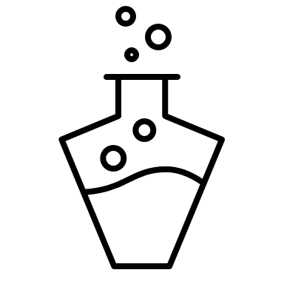
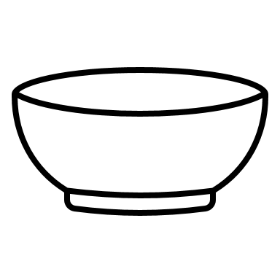


Surface Tension Boat
What you need:
Washing up liquid ​
Bowl​
Paper​
Scissors​
Cotton bud​
Jug of water ​
TEMPLATE
The Science
This is all about surface tension. When the boat is sitting on the surface of the water, the surface tension holds it equally on all sides so the boat does not move. Washing up liquid has a different surface tension, so when you add it to the back channel of your boat there is a change in surface tension around the boat. It is lower at the back than at the front and this difference in the surface tension makes the boat move forward.
What you do:
Copy the template onto a piece of paper. ​
Cut it out and make sure you have a small area at the back of the boat cut out too.
Fill the bowl with water and gently place your boat on top of the water – it will float. ​
Place some washing up liquid on the cotton bud and dip it in the water at the small cut out area at the back of the boat.
Watch what happens.

